Slide 1

307102 Descriptive Statistics for Business
Introduction to Hypothesis Testing
2024-2

Slide 2
Content
One Sample T Test
Two Samples Un-Paired T Test
Two Samples Paired T Test
One-Way ANOVA Test
Two-Way ANOVA Test
Test for Proportions
Chi-Square Test

Slide 3
Hypothesis Testing
Hypothesis Testing is a statistical method that uses sample data to evaluate a hypothesis about a population parameter.
A hypothesis is a claim about a population parameter that can be examined.
The purpose of hypothesis testing is to determine whether there is enough evidence in a sample of data to support a particular belief about a population.
Examples of claims that can be checked:
Testing if a new marketing campaign increases customer engagement.
Checking whether a redesigned website improves conversion rates.
Evaluating if a new product packaging affects sales volume.
Determining if weekend promotions boost in-store foot traffic.
Assessing whether remote work impacts employee productivity.
Comparing customer satisfaction between two service locations.
Testing if a loyalty program increases repeat purchase rates.
Seeing if a price change affects total revenue.
Checking whether a new supplier leads to fewer product defects.
Measuring if training improves sales team performance.

Slide 4
Business Related Examples in Hypothesis Testing
Category | Scenario | Type of Test | Detailed Experiment Design
Marketing | Testing if a new marketing campaign increases customer engagement. | Proportion | Compare engagement rates (clicks, opens) between users exposed to the new vs. old campaign. Randomly assign at least 500 customers to two groups: one receiving the new campaign, one the old. Track engagement (clicks/opens) over a week.
 | Seeing if a promotional email improves open or click-through rates. | Proportion | Compare open/click-through rates between two versions of an email. Send Version A to 1,000 customers and Version B to another 1,000. Ensure equal demographic spread. Compare open and click-through rates.
 | Measuring whether influencer partnerships drive more traffic to the site. | Mean | Compare average daily website visits with and without influencer campaigns. Track daily website traffic for 30 days before and after the influencer campaign. Use rolling averages to minimize noise.
 | Evaluating if social media ads result in more conversions. | Proportion | Compare conversion rates for users who saw the ads vs. those who did not. Randomly expose 5,000 users to social media ads while keeping a matched control group unexposed. Track conversion behavior over 7 days.
Sales & Revenue | Determining if a price change affects total revenue. | Mean | Compare average revenue per user before and after price change. Collect revenue data for 4 weeks before and after price change. Use at least 1,000 transactions in each period to ensure reliability.
 | Testing whether bundling products increases average order value. | Mean | Compare average order value for bundled vs. unbundled products. Assign 500 customers to view bundled product pricing and 500 to unbundled. Track order values across one sales cycle.
 | Assessing if offering free shipping improves purchase completion rates. | Proportion | Compare checkout completion rates with and without free shipping. Split 2,000 checkout users evenly into groups with and without free shipping. Track completion rate within 24 hours.

Slide 5
Category | Scenario | Type of Test | Detailed Experiment Design
Operations | Checking whether a new supplier leads to fewer product defects. | Proportion | Compare defect rates between products from the old vs. new supplier. Collect defect data from 1,000 units produced using the old supplier and 1,000 from the new. Monitor under similar production conditions.
 | Evaluating if a new production method reduces waste or error rates. | Mean | Compare mean waste/error amounts using old vs. new methods. Run the production process using each method for a week, generating at least 500 measurements of waste or errors per method.
 | Determining if delivery time decreases with a new logistics provider. | Mean | Compare average delivery times between the two providers. Record 1,000 delivery times for each provider across the same set of shipping regions and similar order types.
Customer Behavior | Testing if a loyalty program increases repeat purchase rates. | Proportion | Compare proportion of returning customers with and without loyalty program. Track purchase frequency over 3 months for 1,000 loyalty program users and 1,000 non-users, matched by purchase history.
 | Seeing if a new mobile app design boosts daily active users. | Mean | Compare average daily users before and after redesign. Monitor app usage data for 30 days before and after the redesign, using data from at least 5,000 active users.
 | Measuring if customer satisfaction differs after a policy change. | Mean | Compare satisfaction ratings before and after the policy change. Survey at least 500 customers before and after the policy change or use NPS ratings from two equivalent time periods.
Human Resources | Assessing whether remote work impacts employee productivity. | Mean | Compare average productivity scores of remote vs. in-office workers. Randomly select 200 remote and 200 in-office employees with similar roles. Track weekly productivity for 1 month.
 | Measuring if training improves sales team performance. | Mean | Compare average sales figures before and after training. Analyze sales data from 100 employees for the 3 months before and after training. Normalize for seasonal trends.
 | Testing if flexible hours reduce employee turnover. | Proportion | Compare turnover rates between employees with and without flexible hours. Track turnover across 1,000 employees with flexible hours and 1,000 without, matched on role and tenure, over a year.

Slide 6
Key Concepts
Null Hypothesis (H₀): A statement of no effect or no difference (usually we want to test this null state against a difference made by an intervention)
Alternative Hypothesis (H₁ or Ha): What you want to prove – a statement of effect or difference.
Significance Level (α): Probability of rejecting H₀ when it is actually true. Common choices: 0.05, 0.01.
p-value: Probability of observing a result at least as extreme as the one obtained, assuming H₀ is true.
Test Statistic: A value calculated from the sample to decide whether to reject H₀.

Slide 7
The Null and The Alternative Hypothesis
When formulating a hypothesis test, we define two hypotheses: the null hypothesis (𝐻₀) and the alternative hypothesis (𝐻₁ or 𝐻ₐ).
These two hypotheses complement each other—only one of them can be valid.
For example, suppose a company claims that the average delivery time of its orders is 3 days.
To test this claim, the company defines the hypotheses as following:
The Null hypothesis 𝐻₀: The average delivery time IS EQUAL TO 3 days.
The Alternative hypothesis 𝐻ₐ: The average delivery time IS NOT 3 days.
Hypotheses are often expressed with symbols like this:
𝐻₀: μ = 3 days
𝐻ₐ: μ ≠ 3 days
Notice that the null hypothesis sets a baseline assuming no difference or effect—in this context, that the mean delivery time is not different from 3 days.
The burden of proof lies with the alternative hypothesis, which must show sufficient evidence that the average delivery time is different from 3 days.

Slide 8
Choosing the Right Test
One-sample z-test or t-test: Compare sample mean to a known value.
Proportion test: Compare sample proportion to a benchmark (e.g., open rate, conversion rate).
Two-sample t-test: Compare means between two groups (e.g., control vs test).
Chi-square test: Compare categorical variables (e.g., customer satisfaction vs region).
ANOVA Test: Compare means between three or more groups.

Slide 9
The Process
State H₀ and Ha.
Choose α (e.g., 0.05).
Collect data and compute a test statistic.
Compute the p-value.
Compare p-value to α.
Decision: Reject or fail to reject H₀.
Note: We cannot we accept the null hypothesis, we can only reject it or fail to reject it.
The basis for this testing process comes from logic.
For example, if our null hypothesis = All students live in Amman, it will be challenging to check if all students live in Amman.
On the other hand, it will be much easier to find just one student who does not live in Amman and therefore reject the null hypothesis.
Rejecting is much easier that proving or accepting the hypothesis.

Slide 10
More about Hypothesis Testing Core Concepts
Alpha value, The Test Statistic and Critical Values, P-Value, Type I and Type II Errors

Slide 11
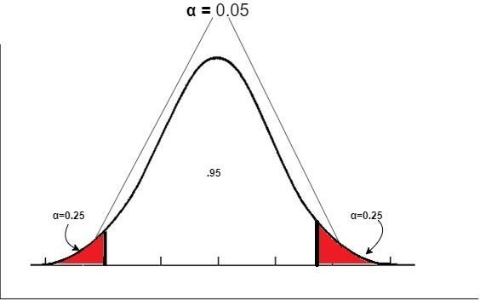
The Significance Level α
Before conducting the test, we need to set the significance level α.
The significance level is a measure of the strength of the evidence that must be present in our sample to reject the null hypothesis and conclude that the effect is statistically significant.
Typical significance levels are: α=0.1 (10%), α=0.05 (5%), α=0.01 (1%)
A lower significance level means that the evidence in the data needs to be stronger to reject the null hypothesis.
There is no "correct" significance level - it only states the amount of uncertainty of the conclusion.
A 5% significance level means that we expect to reject a true null hypothesis 5 out of 100 times (Type I Error).

Slide 12
The Test Statistic
The test statistic is the value we compute based on the sample data that we collect.
The test statistic is used to decide the outcome of the hypothesis test.
We standardize test statistic using:
Z Standard Normal Distribution for large samples or when the variance is known.
The Student's T-Distribution (T) for small samples and the population variance is unknown.

Slide 13
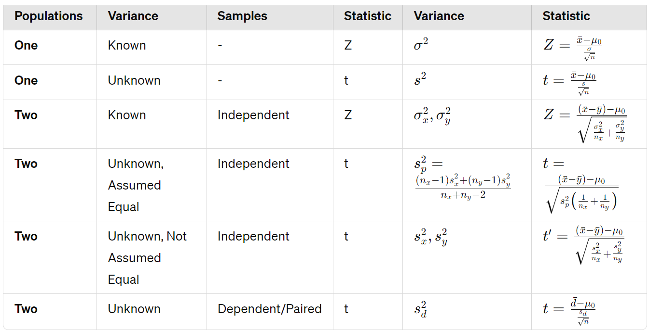
Computing the Test Statistic

Slide 14
A Word about The Types of Populations Hypothesis Tests
Basically, there are many types of tests that are available.
The type of test depends on the number of populations involved in the test, the value being tested(numerical or categorical), the knowing of the variance and the sample size.
Z-test: Used for normally distributed data when the variance is known.
One-sample z-test: Tests the mean of a single group against a known mean.
Two-sample z-test: Compares the means of two dependent groups (paired test).
Two-sample z-test: Compares the means of two independent groups.
T-test: Used for normally distributed data when the variance is unknown.
One-sample t-test: Tests the mean of a single group against a known mean.
Two-sample t-test: Compares the means of two dependent groups (paired test).
Two-sample t-test: Compares the means of two independent groups (variance assumed to be equal).
Two-sample t-test: Compares the means of two independent groups (variance assumed to be not equal).
Proportion Test: Compare sample proportion to a benchmark (e.g., open rate, conversion rate).
ANOVA (Analysis of Variance): Used to compare the means of three or more samples.
Chi-square test: Tests for relationships between categorical variables.

Slide 15

The Critical Value and the p-Value Approach to Hypothesis Testing
To decide whether to reject the null hypothesis, a test statistic is calculated.
The decision is made based on the numerical value of that test statistic.
There are two approaches how to arrive at that decision: The critical value approach and the p-value approach.
The critical value approach
By applying the critical value approach, it is determined, whether the observed test statistic is more extreme than a defined critical value.
Therefore, the observed test statistic (calculated based on sample data) is compared to the critical value (a kind of cutoff value).
If the test statistic is more extreme than the critical value, the null hypothesis is rejected.
If the test statistic is not as extreme as the critical value, the null hypothesis is not rejected.
The critical value is computed based on the given significance level α and the type of probability distribution of the idealized model.
The critical value divides the area under the probability distribution curve in rejection region(s) and non-rejection region.

Slide 16
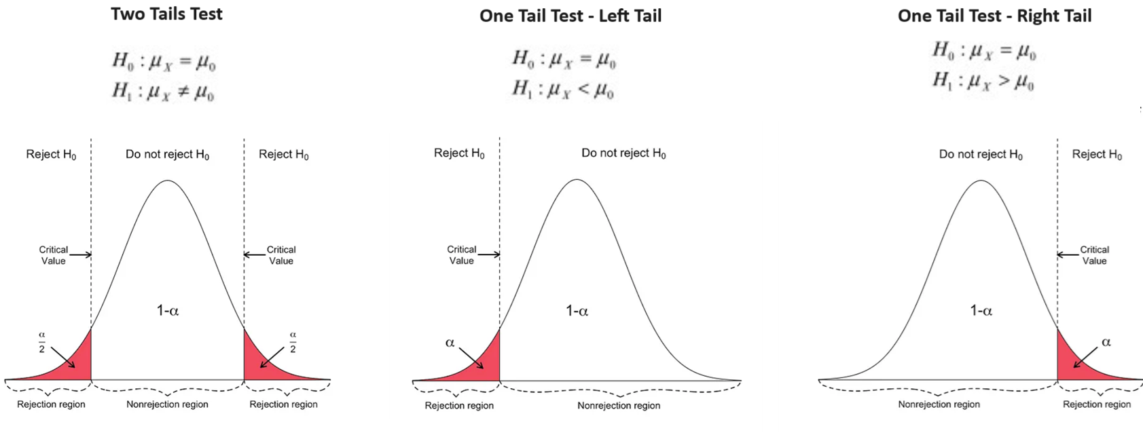
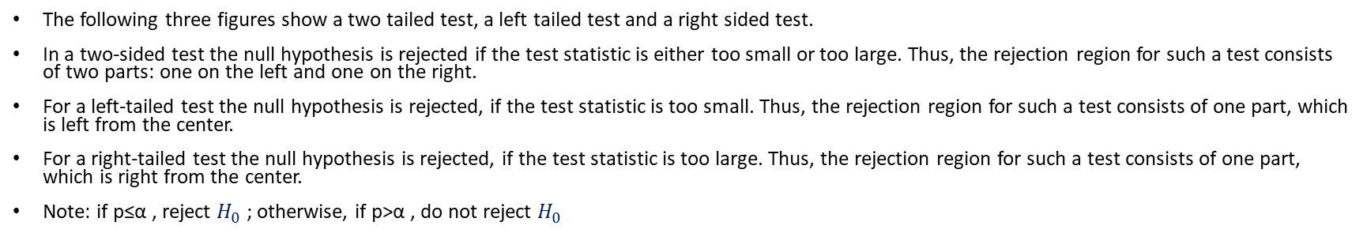
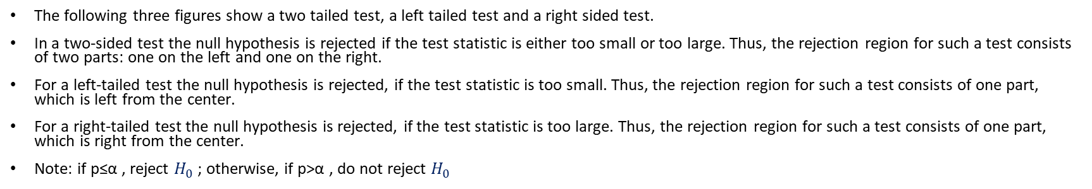
The Critical Value Approach to Hypothesis Testing
The following three figures show a two tailed test, a left tailed test and a right sided test.
In a two-sided test the null hypothesis is rejected if the test statistic is either too small or too large. Thus, the rejection region for such a test consists of two parts: one on the left and one on the right.
For a left-tailed test the null hypothesis is rejected, if the test statistic is too small. Thus, the rejection region for such a test consists of one part, which is left from the center.
For a right-tailed test the null hypothesis is rejected, if the test statistic is too large. Thus, the rejection region for such a test consists of one part, which is right from the center.
Note: if p≤α , reject $H_{0}$ ; otherwise, if p>α , do not reject $H_{0}$

Slide 17
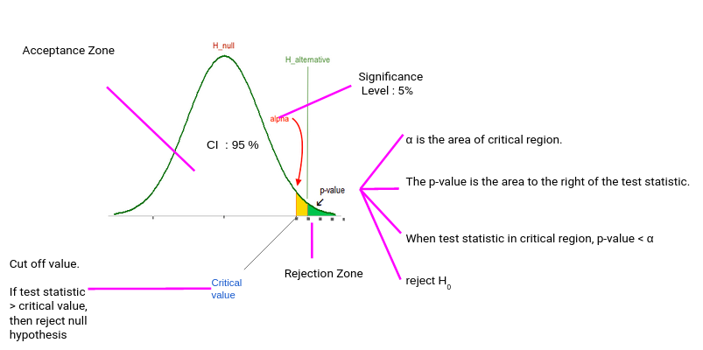
The p-Value Approach to Hypothesis Testing
The p-value represents:
The probability of observing the sample data or more extreme values, given that the null hypothesis is true.
The amount of evidence against the null hypothesis, the smaller (closer to 0) the p-value, the stronger is the evidence against the null hypothesis.
If the p-value (Green Area) is less than or equal to the specified significance level α (Yellow Area) , the null hypothesis is rejected. Otherwise, we fail to reject the null hypothesis.

Slide 18
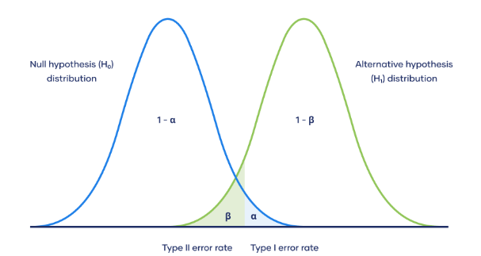
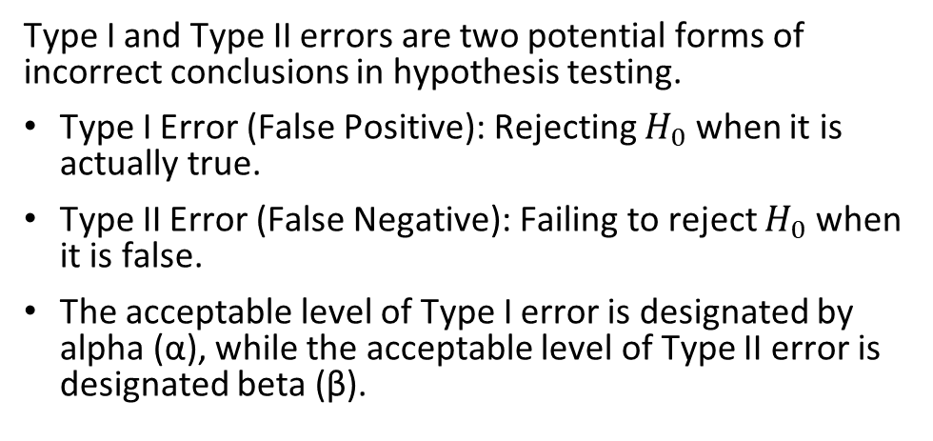
Type I and Type II Errors
Type I and Type II errors are two potential forms of incorrect conclusions in hypothesis testing.
Type I Error (False Positive): Rejecting $H_{0}$ when it is actually true.
Type II Error (False Negative): Failing to reject $H_{0}$ when it is false.
The acceptable level of Type I error is designated by alpha (α), while the acceptable level of Type II error is designated beta (β).
A Type I error occurs when the null hypothesis is incorrectly rejected when it is actually true.
Conversely, a Type II error happens when the null hypothesis is not rejected when it is in fact false, akin to a false negative, where we fail to detect a true effect or difference.
Consider a pharmaceutical company deciding whether a new drug is effective. A Type I error would occur if the company concludes the drug works when it does not, potentially leading to a costly recall and reputation damage when the truth emerges.
On the other hand, a Type II error would be failing to recognize the drug's efficacy, missing out on the opportunity to bring a beneficial product to market, which can result in lost revenue and competitive disadvantage. The company must balance these risks, often prioritizing the avoidance of one type of error over the other based on the potential costs and impacts associated with each.

Slide 19
Hypothesis Testing Examples

Slide 20
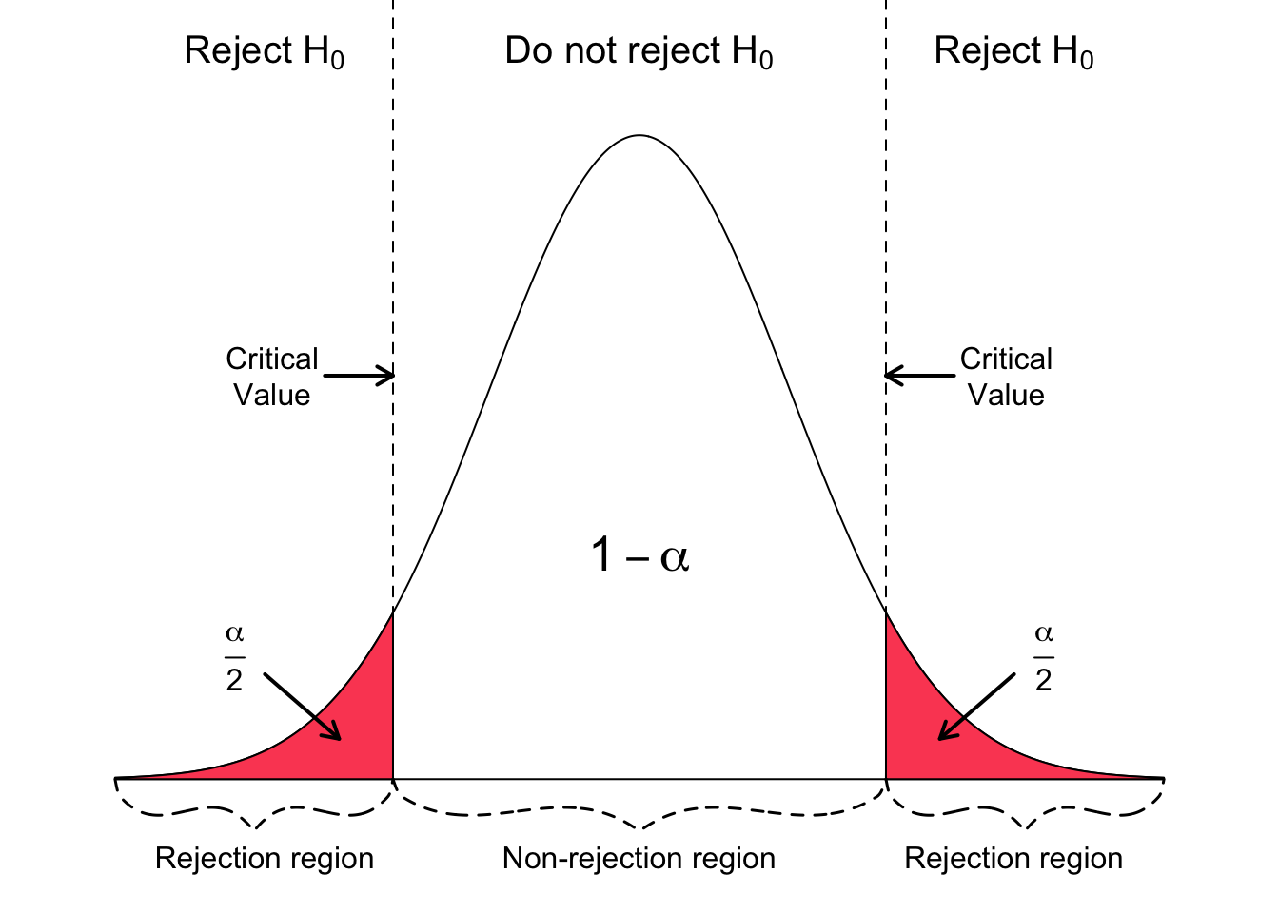
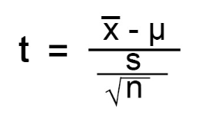
One Sample Test – Testing for Two Tails
Scenario: A logistics company believe that its average delivery time is equal to 3 days.
The company wants to test this belief.
Therefore, the company sets the test hypothesis as follows:
Is there enough evidence (at α = .05) to conclude that the population mean delivery time for the company is equal to 3 days?
H₀: μ = 3
Ha: μ ≠ 3
The company then collected a sample data of 40 deliveries times.
Using the collected data, the t-statistic will be computed.
If the test statistic is within the rejection region, we reject the null hypothesis, otherwise we fail to reject the null hypothesis.

Slide 21
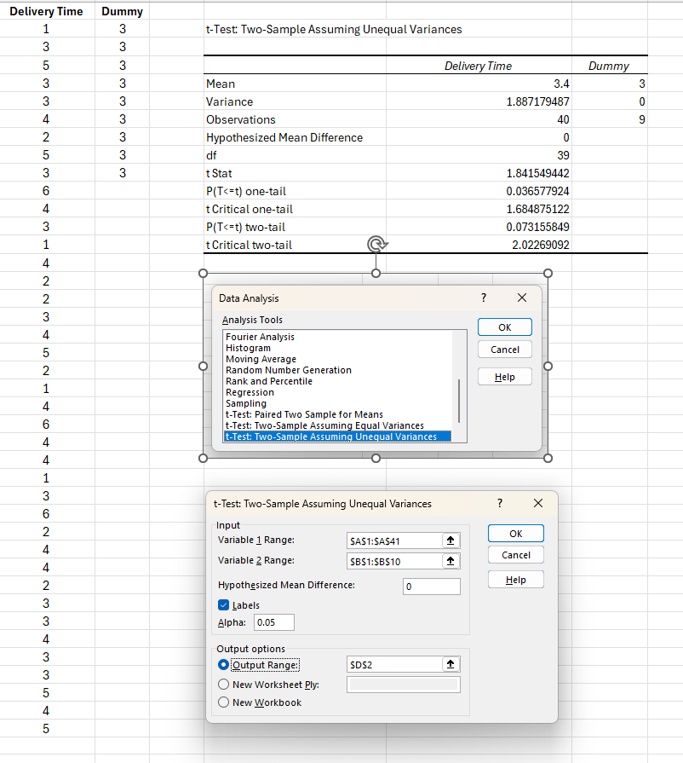
Implement the Test in Excel
Delivery Times for 40 Days Sample – In Days
1 | 4 | 1 | 4
3 | 3 | 4 | 2
5 | 1 | 6 | 3
3 | 4 | 4 | 3
3 | 2 | 4 | 4
4 | 2 | 1 | 3
2 | 3 | 3 | 3
5 | 4 | 6 | 5
3 | 5 | 2 | 4
6 | 2 | 4 | 5
Test Results
 | Delivery Times
Mean | 3.4
Variance | 1.887179487
Observations | 40
Hypothesized Mean Difference | 0
df | 39
t Stat | 1.841549442
P(T<=t) one-tail | 0.036577924
t Critical one-tail | 1.684875122
P(T<=t) two-tail | 0.073155849
t Critical two-tail | 2.02269092
1
According to the test results, we fail to reject the null hypothesis which states that the mean delivery time is equal to 3 days.
The collected sample data did not provide us with sufficient evidence to conclude that the mean delivery time is different from 3.
We reached this conclusion because the t statistic falls inside the non-rejection region.
We also reached that conclusion because the p-value (0.07315) which is greater than alpha 0.05.
Computing t-statistic manually, t = (3.4 - 3) / (1.37 / √40) ≈ 1.84
2

Slide 22
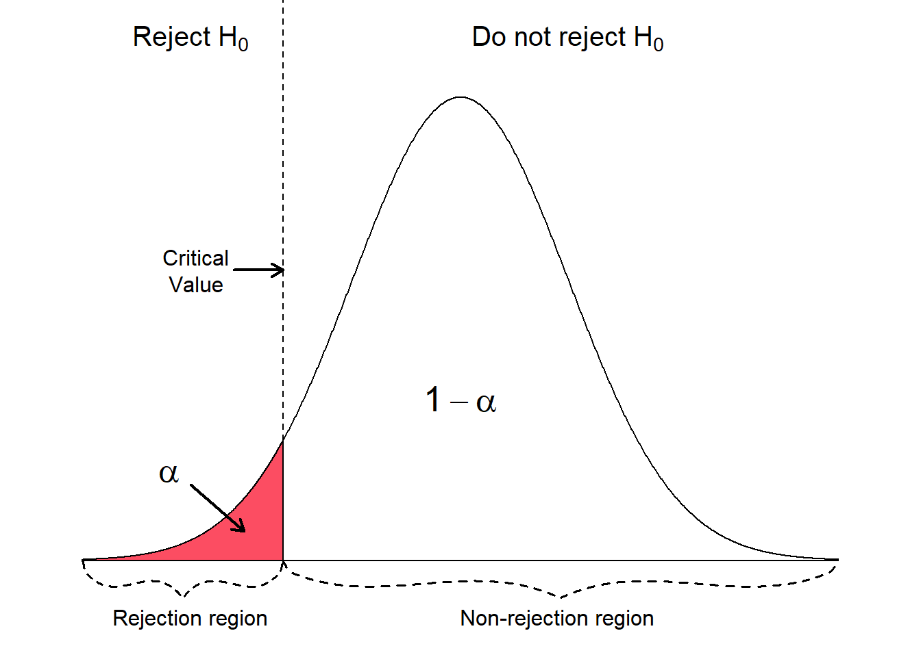

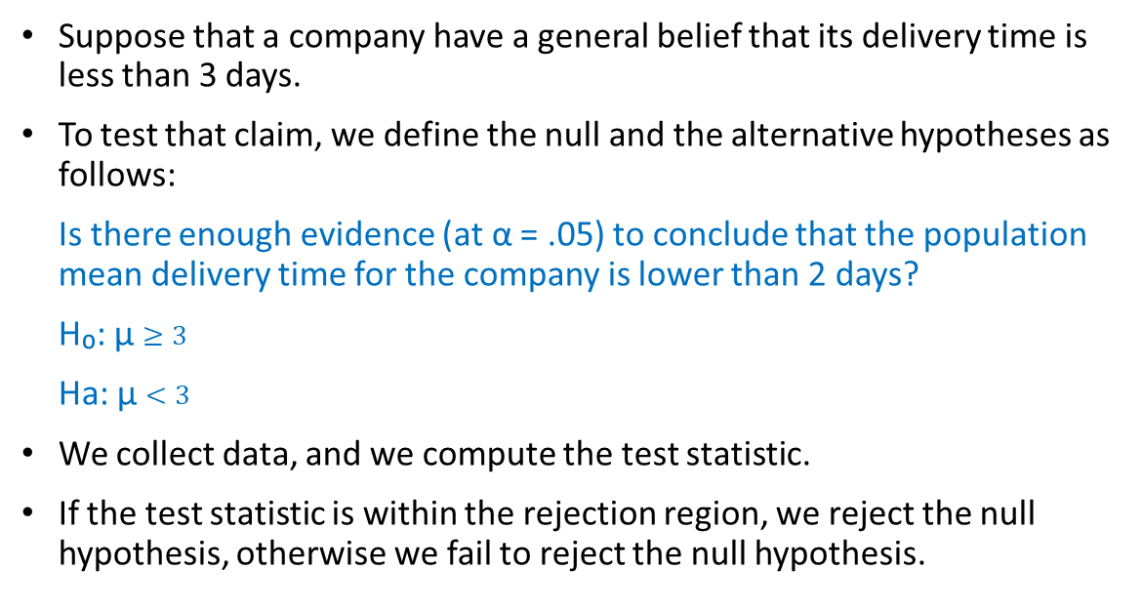
One Sample - One Tailed Test (Lower Tail Test)
Suppose that a company have a general belief that its delivery time is less than 3 days.
To test that claim, we define the null and the alternative hypotheses as follows:
Is there enough evidence (at α = .05) to conclude that the population mean delivery time for the company is lower than 2 days?
H₀: μ $≥3$
Ha: μ $<3$
We collect data, and we compute the test statistic.
If the test statistic is within the rejection region, we reject the null hypothesis, otherwise we fail to reject the null hypothesis.

Slide 23
Implement the Test in Excel
Delivery Times for 40 Days Sample – In Days
1 | 4 | 1 | 4
3 | 3 | 4 | 2
5 | 1 | 6 | 3
3 | 4 | 4 | 3
3 | 2 | 4 | 4
4 | 2 | 1 | 3
2 | 3 | 3 | 3
5 | 4 | 6 | 5
3 | 5 | 2 | 4
6 | 2 | 4 | 5
Test Results
 | Delivery Times
Mean | 3.4
Variance | 1.887179487
Observations | 40
Hypothesized Mean Difference | 0
df | 39
t Stat | 1.841549442
P(T<=t) one-tail | 0.036577924
t Critical one-tail | 1.684875122
P(T<=t) two-tail | 0.073155849
t Critical two-tail | 2.02269092
1
According to the test results, we fail to reject the null hypothesis which states that the mean delivery time is greater than or equal to 3 days.
The collected sample data provided us with significant evidence (at alpha 0.05) to conclude that the mean delivery time is equal or higher than 3 days.
We reached this conclusion because the t statistic falls inside the non-rejection region of the null hypothesis.
We also reached that conclusion because the p-value (0.0365) which is less than alpha 0.05.
Computing t-statistic manually, t = (3.4 - 3) / (1.37 / √40) ≈ 1.84
2

Slide 24
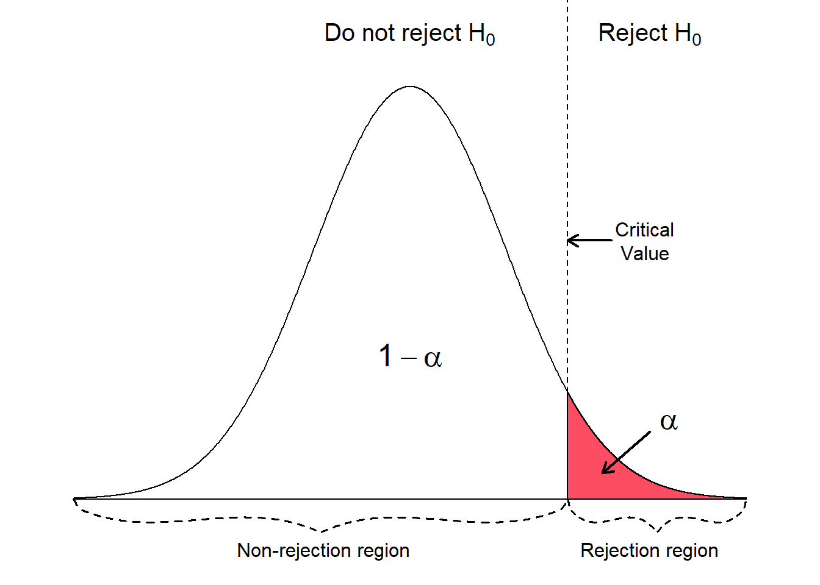
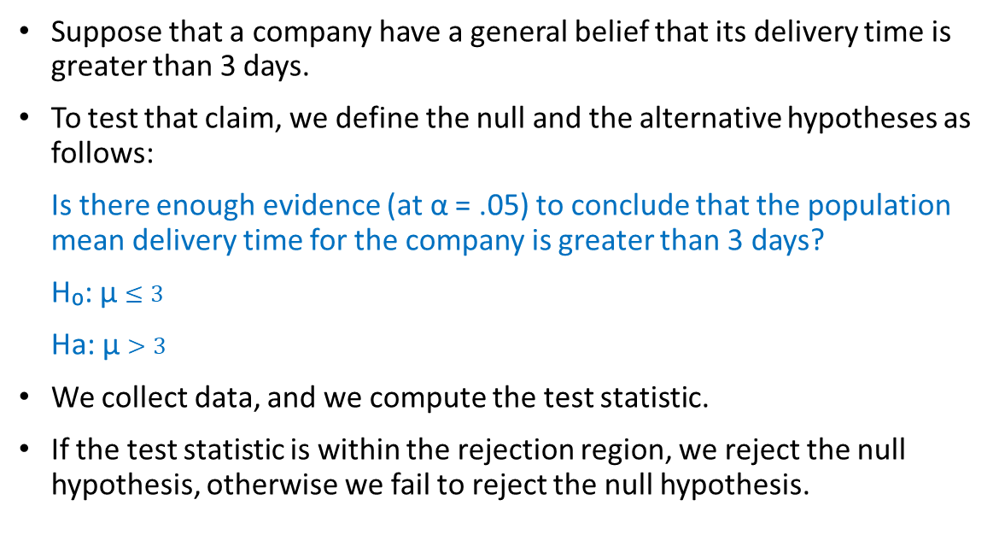
One Sample - One Tailed Test (Upper Tail Test)
Suppose that a company have a general belief that its delivery time is greater than 3 days.
To test that claim, we define the null and the alternative hypotheses as follows:
Is there enough evidence (at α = .05) to conclude that the population mean delivery time for the company is greater than 3 days?
H₀: μ $≤3$
Ha: μ $>3$
We collect data, and we compute the test statistic.
If the test statistic is within the rejection region, we reject the null hypothesis, otherwise we fail to reject the null hypothesis.

Slide 26
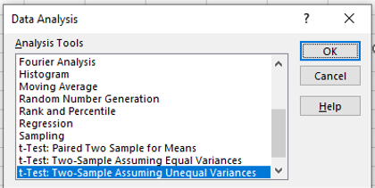
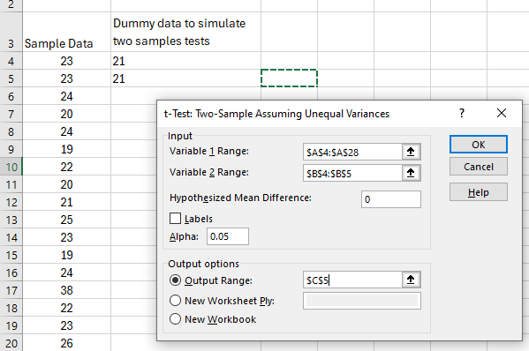
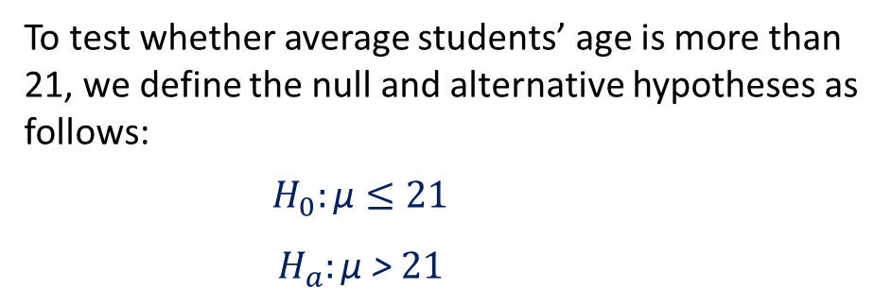
One Sample - One Tailed Test (Upper Tail Test)
Is there enough evidence (at α = .05) to conclude that the population mean age for the university students is higher than 21 based on the following sample data?
1
23 | 19 | 23 | 23 | 21
23 | 22 | 19 | 26 | 23
24 | 20 | 24 | 20 | 26
20 | 21 | 38 | 19 | 20
24 | 25 | 22 | 21 | 23
2
To test whether average students’ age is more than 21, we define the null and alternative hypotheses as follows:
$$H_{0}:\text{µ}≤21$$
$$H_{a}:\text{µ}\text{ > }21$$

Slide 27
One Sample - One Tailed Test (Upper Tail Test)
According to the test results, we reject the null hypothesis that the mean is less than or equal to 21.
Using our sample data, we found that the average students age is more than 21 with significant evidence.
We reached this conclusion because the t statistic is larger than the critical value (falls inside the rejection region).
We also reached that conclusion because the p-value (0.014) which is less than 0.05.
 | Age | Dummy
Mean | 22.76 | 21
Variance | 14.44 | 0
Observations | 25 | 2
Hypothesized Mean Difference | 0
df | 24
t Stat | 2.315789474
P(T<=t) one-tail | 0.014715837
t Critical one-tail | 1.71088208
P(T<=t) two-tail | 0.029431673
t Critical two-tail | 2.063898562

Slide 28
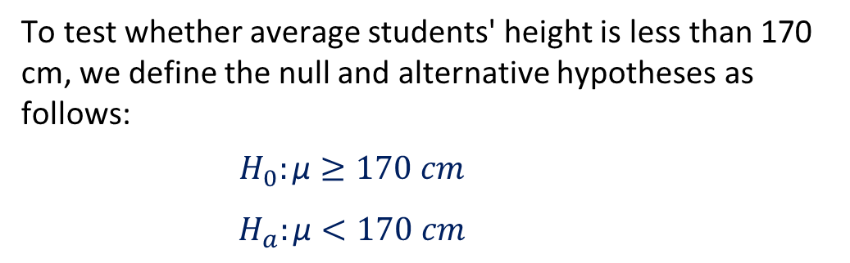
One Sample - One Tailed Test (Lower Tail Test)
Is there enough evidence (at α = .05) to conclude that the population mean height for the university students is less than 170 based on the following sample data?
175.65 | 164.61 | 165.96 | 168.59
171.82 | 167.32 | 175.88 | 167.56
166.08 | 167.17 | 164.32 | 163.92
167.49 | 175.20 | 172.61 | 176.43
169.61 | 163.77 | 171.58 | 174.42
To test whether average students' height is less than 170 cm, we define the null and alternative hypotheses as follows:
$$H_{0}:\text{µ}≥170 cm$$
$$H_{a}:\text{µ}<170 cm$$

Slide 29
Hypothesis Testing for Two Populations Means

Slide 30
Types of Hypothesis Tests
Z-test: Used for normally distributed data when the variance is known.
One-sample z-test: Tests the mean of a single group against a known mean.
Two-sample z-test: Compares the means of two dependent groups (paired test).
Two-sample z-test: Compares the means of two independent groups.
T-test: Used for normally distributed data when the variance is unknown.
One-sample t-test: Tests the mean of a single group against a known mean.
Two-sample t-test: Compares the means of two dependent groups (Paired t test).
Two-sample t-test: Compares the means of two independent groups (variance assumed to be equal).
Two-sample t-test: Compares the means of two independent groups (variance assumed to be not equal).
ANOVA (Analysis of Variance): Used to compare the means of three or more samples.
Chi-square test: Tests for relationships between categorical variables.

Slide 31
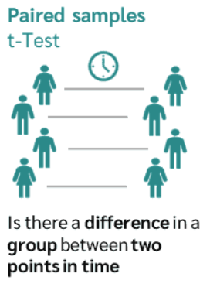
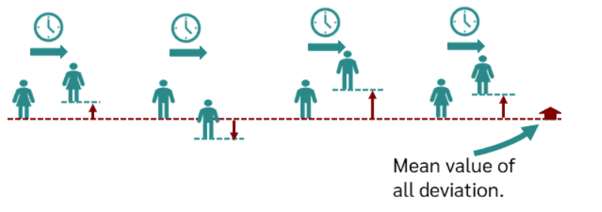
Compares the means of two dependent groups (Paired T Test)
The dependent samples T-test (or paired samples t-test) is a statistical test that determines whether there is a difference between two dependent groups or samples.
We need the paired t-test whenever we survey the same group or sample at two points in time.
This can be the case, for example, in longitudinal studies with several measurement points (time series analyses) or in intervention studies with experimental designs (before-after measurement).
An example of dependent sampling is when the weight of a group of people is measured at two points in time (before and after going into a diet).
The weight of a person can be measured individually before and after going into the diet, and the difference in the measured values can be calculated in each case.

Slide 32
Compares the means of two dependent groups (Paired T Test)
We are interested in the question whether an online statistics learning tutorial helps students improve their grades.
There are three variables of interest in the student's data set (score1, score2 and online.tutorial).
The variables score1 and score2 show the grades (0-100) for two exams on mathematics after attending online training. The higher the value the better the student performed.
The variable online.tutorial is a binary variable, which is 1 if the student completed the online statistics learning tutorial, or 0 otherwise.
The first exam takes place before the students attended the online statistics learning tutorial.
The participation in the online statistics learning tutorial is not mandatory, however the two exams are obligatory for all students.
We want to examine if the group of students, which attended the online statistics learning tutorial, performs better on the second exam compared to the first exam.
Random sample of students who took the online training
` | Score 1 | Score 2
1 | 67 | 71
2 | 62 | 64
3 | 60 | 57
4 | 53 | 52
5 | 75 | 77
6 | 64 | 79
7 | 43 | 48
8 | 74 | 70
9 | 59 | 53
10 | 54 | 58
11 | 66 | 66
12 | 81 | 90
13 | 55 | 57
14 | 64 | 68
15 | 72 | 71
16 | 76 | 78
17 | 75 | 73
18 | 90 | 92
19 | 83 | 90
20 | 64 | 73
21 | 49 | 51
22 | 41 | 51
23 | 75 | 87
24 | 66 | 66
25 | 75 | 74
26 | 49 | 57
27 | 91 | 89
28 | 68 | 69
29 | 72 | 72
30 | 87 | 93
$$H_{0}:{\text{µ}}_{score2}≤{\text{µ}}_{score1}$$ | Null Hypothesis states that there is no effect for the intervention
$$H_{1}:{\text{µ}}_{score2\text{ > }}{\text{µ}}_{score1}$$ | Alternative Hypothesis claims that the intervention caused an effect

Slide 33
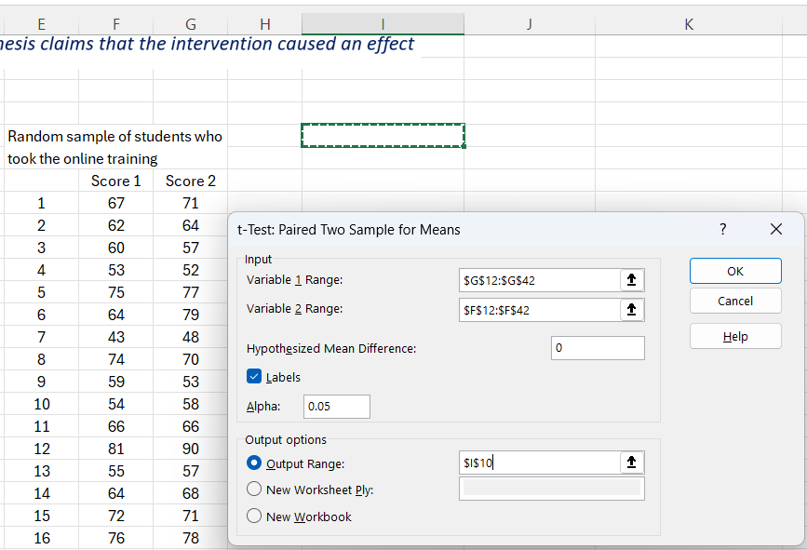
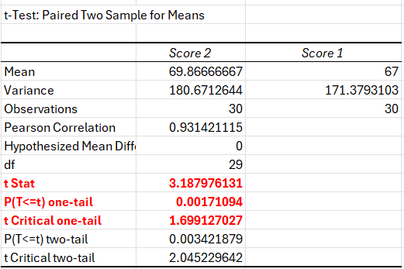
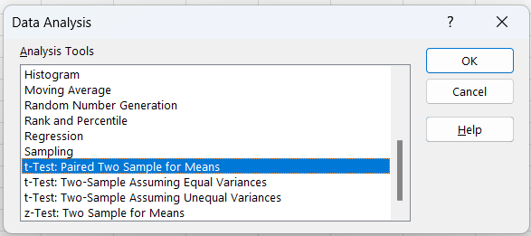
Compares the means of two dependent groups (Paired T Test)
2
3
1
Based on the sample data and the test statistic, we found that there is a statistically significant difference between the before and after score, the after score (score2) is higher than score1.
This finding is supported by the test statistic and the p-value, therefore we REJECT the null hypothesis, and we conclude that the online tutorial helped students in enhancing their exam performance.

Slide 34
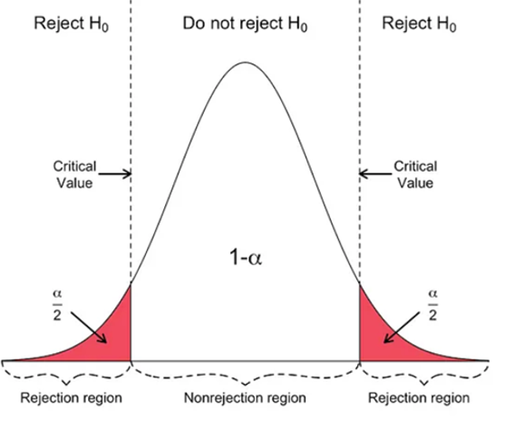

Compares the means of two independent groups (variance assumed to be equal)
In this section we perform a hypothesis test for the means of two populations.
We examine the mean annual salary (in Euro) of graduates.
The first population consist of male students and the second population of female students.
The standard deviations of the two populations are unknown but assumed to be equal.
The question is, whether there is a difference (at α 5%) in the mean annual salary of graduates related to gender (two tailed test)
 | Male Random Sample | Female Random Sample
1 | $39,647.68 | $29,543.60
2 | $55,726.10 | $30,972.76
3 | $34,717.77 | $33,216.12
4 | $29,999.35 | $24,143.27
5 | $50,763.66 | $40,466.69
6 | $52,433.73 | $29,543.60
7 | $44,385.84 | $47,760.48
8 | $36,599.27 | $45,054.95
9 | $47,842.44 | $42,742.79
10 | $30,854.42 | $42,202.39
11 | $58,614.72 | $40,606.41
12 | $62,887.03 | $29,783.76
13 | $48,288.53 | $46,945.17
14 | $43,191.15 | $29,555.94
15 | $43,756.58 | $45,042.30
16 | $48,453.00 | $29,555.94
17 | $23,090.67 | $45,625.09
18 | $55,660.20 | $28,017.87
19 | $57,527.17 | $35,840.90
20 | $65,776.23 | $33,648.38
21 | $50,011.69 | $46,858.67
22 | $46,213.64 | $42,463.48
23 | $42,211.41 | $33,200.27
24 | $61,384.55 | $28,338.17
25 | $49,780.18 | $26,265.35
26 | $50,474.57 | $34,373.99
27 | $43,281.92 | $37,312.85
28 | $55,484.64 | $37,709.73
29 | $24,409.73 | $35,106.01
30 | $40,489.49 | $37,807.11
$$H_{0}:{\text{µ}}_{male}={\text{µ}}_{female}$$ | Null Hypothesis states that there is no difference
$$H_{1}:{\text{µ}}_{male \text{≠} }{\text{µ}}_{female}$$ | Alternative Hypothesis claims that there is a difference

Slide 35
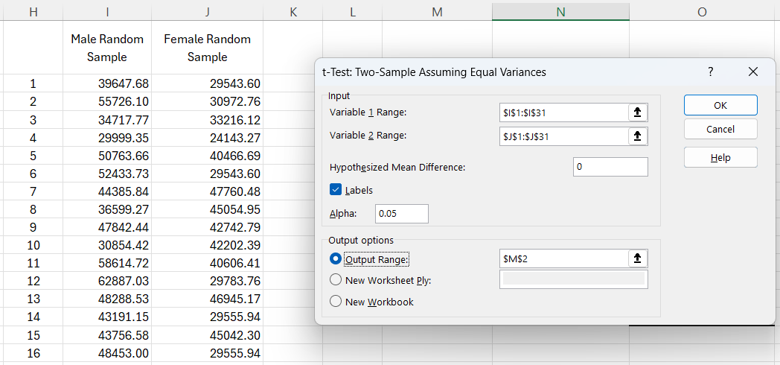
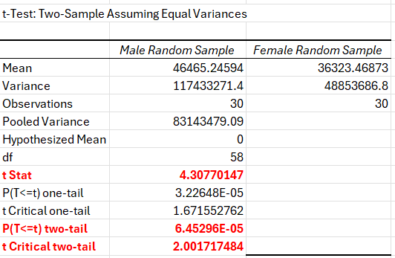
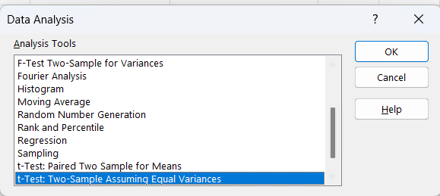
Compares the means of two independent groups (variance assumed to be equal)
3
2
1
Based on the sample data and the test statistic, we found that there is a statistically significant difference between male salaries and female salaries.
This finding is supported by the test statistic and the p-value, therefore we REJECT the null hypothesis, and we conclude that the salaries of male graduates and female graduates are not equal.

Slide 36

Compares the means of two independent groups (variance assumed to be not equal)
In this section we perform a hypothesis test for the means of two populations.
To showcase the non-pooled t-test we test a claim that states that the annual salaries for political science female students is higher than the annual salaries of the social science female students.
The standard deviations of the two populations are unknown and assumed to be unequal.
We want to test at α 1%, whether the mean political science salary is higher than the mean salary of the social science (one tail test, upper tail).
 | Political Science Random Sample | Social Science Random Sample
1 | $30,796.16 | $33,641.73
2 | $32,038.41 | $29,635.67
3 | $32,038.41 | $38,738.01
4 | $32,996.39 | $21,453.99
5 | $33,648.38 | $31,484.80
6 | $41,430.16 | $34,287.96
7 | $40,032.78 | $35,583.43
8 | $39,710.80 | $28,672.85
9 | $36,911.26 | $30,062.71
10 | $45,900.13 | $34,420.48
11 | $35,270.19 | $33,641.73
12 | $43,318.41 | $26,291.32
13 | $41,282.13 | $31,151.42
14 | $41,430.16 | $38,738.01
15 | $21,485.62 | $33,565.74
16 | $29,195.50 | $31,484.80
17 | $45,141.81 | $32,194.59
18 | $34,492.08 | $35,746.22
19 | $27,893.26 | $28,281.25
20 | $38,591.54 | $31,405.48
21 | $33,726.58 | $32,194.59
22 | $29,832.22 | $35,987.41
23 | $32,154.94 | $35,583.43
24 | $34,686.49 | $34,227.49
25 | $25,607.82 | $25,758.88
26 | $33,726.58 | $34,373.99
27 | $37,782.86 | $25,658.83
28 | $35,507.83 | $34,201.58
29 | $33,955.21 | $31,151.42
30 | $25,883.03 | $33,641.73
$$H_{0}:{\text{µ}}_{political science}≤{\text{µ}}_{social science}$$ | Null Hypothesis states that the salaries are equal
$$H_{1}:{\text{µ}}_{political science\text{ > }}{\text{µ}}_{social science}$$ | Alternative Hypothesis claims that political science is higher

Slide 37
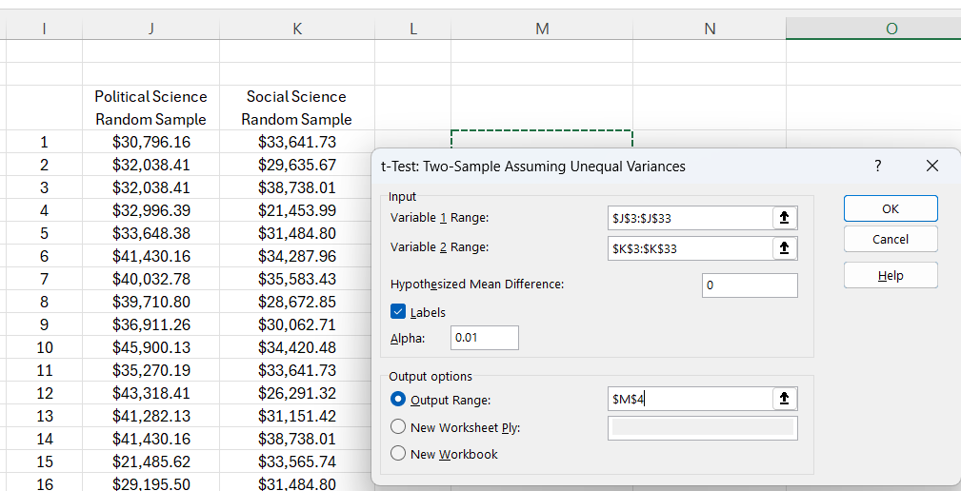
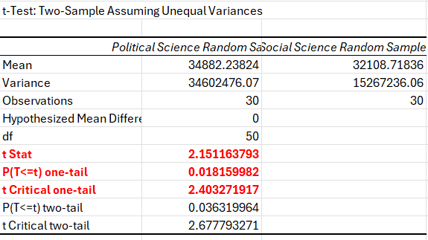
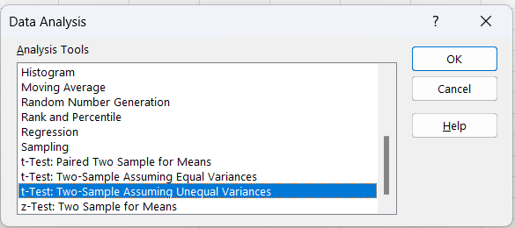
Compares the means of two independent groups (variance assumed to be not equal)
2
3
1
Based on the sample data and the test statistic, we found that there is no statistically significant difference (at α 1%) between the salaries of political science and social science.
This finding is supported by the test statistic and the p-value, therefore we FAIL TO REJECT the null hypothesis which states that the salaries of political science and social science are equal for female graduates.

Slide 38
Hypothesis Testing for More than Two Populations Means
One Way ANOVA

Slide 39
Introduction to One-Way ANOVA
Definition: One-Way ANOVA is a statistical test that compares the means of three or more independent groups to determine if at least one group mean is statistically different from the others.
Purpose: To test for significant differences between the means of multiple groups when you have one categorical independent variable and one continuous dependent variable.
Appropriate Use Cases:
Comparing customer satisfaction levels across different store locations.
Examining student performance across different teaching methods.
Key Advantage:
Allows simultaneous comparison of more than two groups, providing a broader analysis than t-tests.

Slide 40
ANOVA
Hypothesis in One-Way ANOVA:
Null Hypothesis (H0): All group means are equal.
Alternative Hypothesis (H1): At least one group mean is different from the others.
How to Calculate?
Calculate Group Means and Overall Mean
Compute Sum of Squares:
Total Sum of Squares (SST): Variability of all data points around the overall mean.
Within-Group Sum of Squares (SSW): Variability within each group.
Between-Group Sum of Squares (SSB): Variability due to the interaction between the groups.
Calculate Mean Squares:
Mean Square Between (MSB): SSB divided by the degrees of freedom between groups (k-1).
Mean Square Within (MSW): SSW divided by the degrees of freedom within groups (N-k).
F-Statistic:
F = MSB / MSW

Slide 41
ANOVA Example
Scenario: A school tests three different teaching methods to determine which one results in the best performance on a standardized test.
The students are randomly assigned to one of three groups, each receiving instruction through a different method. Their scores on a standardized test are recorded.
Variables:
Group: The teaching method group (A, B, C)
Score: The score each student received on the standardized test.
Student ID | Group | Score
1 | A | 82
2 | A | 88
3 | A | 84
4 | A | 90
5 | A | 85
6 | B | 78
7 | B | 75
8 | B | 80
9 | B | 82
10 | B | 77
11 | C | 90
12 | C | 92
13 | C | 95
14 | C | 91
15 | C | 94

Slide 42
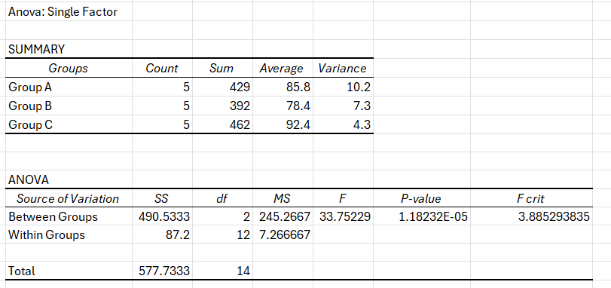
Interpreting Results
F-Statistic and P-Value:
An F-Statistic higher than the critical value or a P-value less than the alpha level (e.g., 0.05) indicates significant differences between group means.
Post Hoc Tests:
If the ANOVA is significant, perform post hoc tests (e.g., Tukey’s HSD) to determine which specific groups differ from each other.
Both the F-Statistic and the P-value indicate significant difference between groups means, therefore we reject the null hypothesis.

Slide 43
2-Way ANOVA
Case Study: Effect of Teaching Method and Gender on Student Performance
Objective:
A school administrator wants to investigate whether student performance is affected by:
Teaching method (Traditional vs. Online)
Student gender (Male vs. Female)
This leads to a 2x2 factorial design:
Factor A: Teaching Method (Traditional, Online)
Factor B: Gender (Male, Female)
Response Variable: Final Exam Score (numerical)

Slide 44
2-Way ANOVA
Gender | Teaching Method | Exam Score
Male | Traditional | 75
Male | Traditional | 78
Female | Traditional | 85
Female | Traditional | 82
Male | Online | 70
Male | Online | 68
Female | Online | 80
Female | Online | 83
 | Traditional |  | Online
 | Male | Female | Male | Female
Score1 | 75 | 85 | 70 | 80
Score2 | 78 | 82 | 68 | 83

Slide 45
Hypothesis Testing for Categorical Data
Chi-Square Tests

Slide 46
Introduction to Chi-Square Tests
Definition: Chi-Square tests are statistical methods used to determine if there is a significant association between categorical variables.
Types of Chi-Square Tests:
Test of Independence: Determines if two or more categories are independent.
Goodness of Fit Test: Determines if a sample matches an expected distribution.

Slide 47
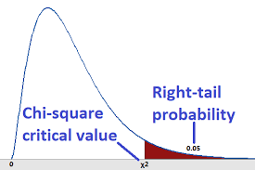
Focus on Chi-Square Test of Independence
Purpose: To assess whether observed frequencies in a contingency table differ significantly from expected frequencies derived from hypothesis.
Applicable Scenarios: Useful in marketing research, opinion polling, healthcare, and demographic studies.

Slide 48
Assumptions of the Chi-Square Test of Independence
Sample Adequacy: The sample size should be large enough, typically each category should have an expected frequency of 5 or more.
Independence: Observations must be independent of each other.
Random Sampling: Data should be collected randomly.
Data Level: The test requires nominal or ordinal data.

Slide 49
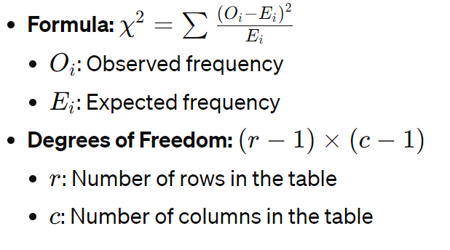
The Chi-Square Statistic

Slide 50
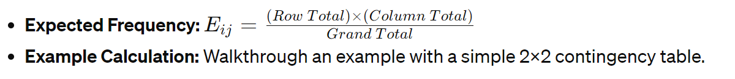
Calculating Expected Frequencies

Slide 51
Conducting the Test
Step-by-Step Process:
Set up the contingency table.
Calculate expected frequencies for each cell.
Compute Chi-Square statistic using the formula.
Compare the calculated Chi-Square to the critical value from Chi-Square distribution table based on degrees of freedom and significance level.

Slide 52
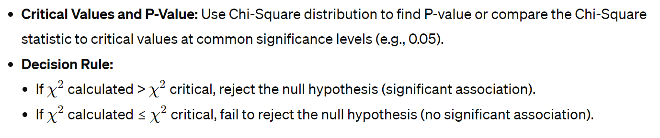
Interpreting Results

Slide 53
Example: Product Preference Across Age Groups
A company wants to determine if there is a significant association between the age group of its customers and their preference for one of two new beverage products. The marketing team has conducted a survey and collected data from different age groups.
Data Collected
Here's the observed frequency table based on the survey:
 | Product A | Product B | Total
Under 30 | 30 | 40 | 70
30 to 50 | 50 | 30 | 80
Over 50 | 20 | 30 | 50
Total | 100 | 100 | 200
Task
Perform a Chi-Square Test of Independence to determine if there's a significant relationship between age group and product preference.

Slide 54
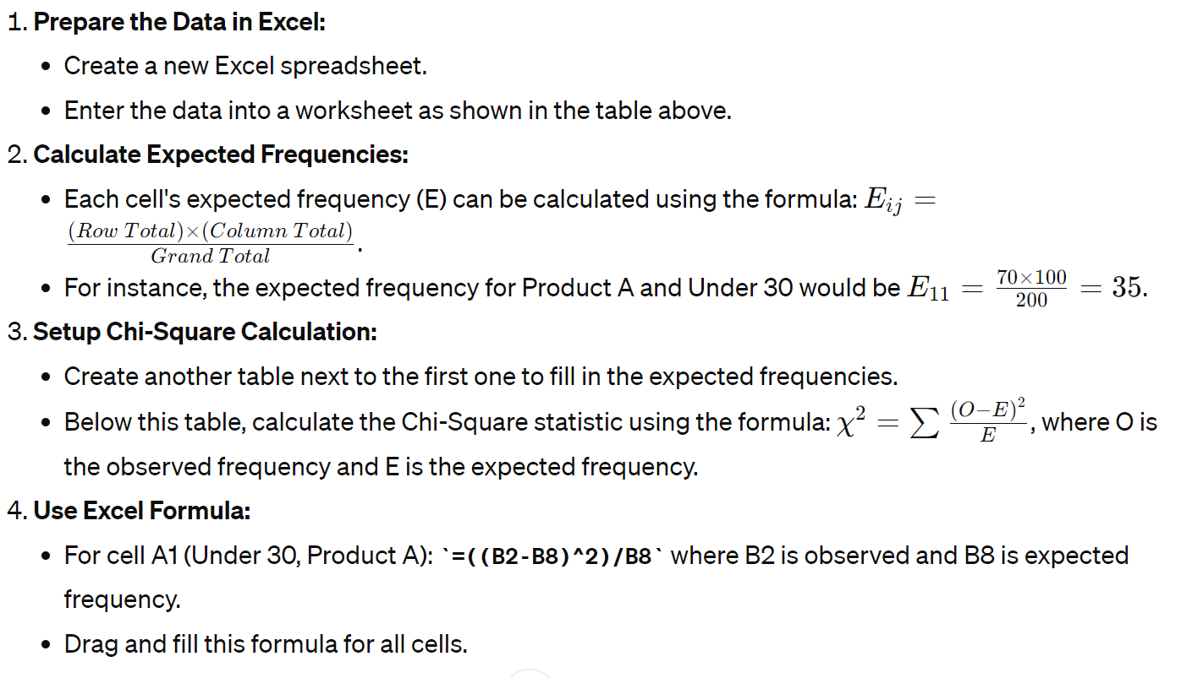
Steps to Solve in Excel

Slide 55
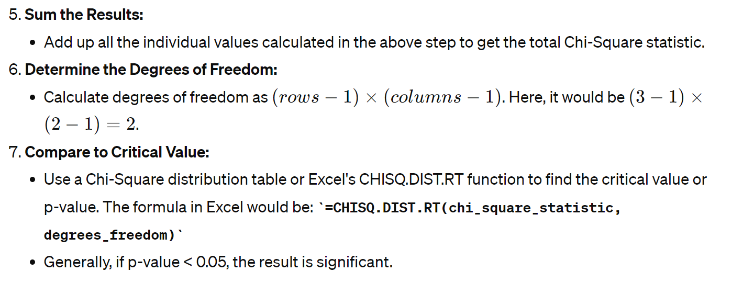
Steps to Solve in Excel

Slide 56
Interpretation
After calculating the Chi-Square statistic and comparing it with the critical value from a Chi-Square distribution table (or using p-value), you can conclude whether there is a statistically significant association between age group and product preference.

Slide 57
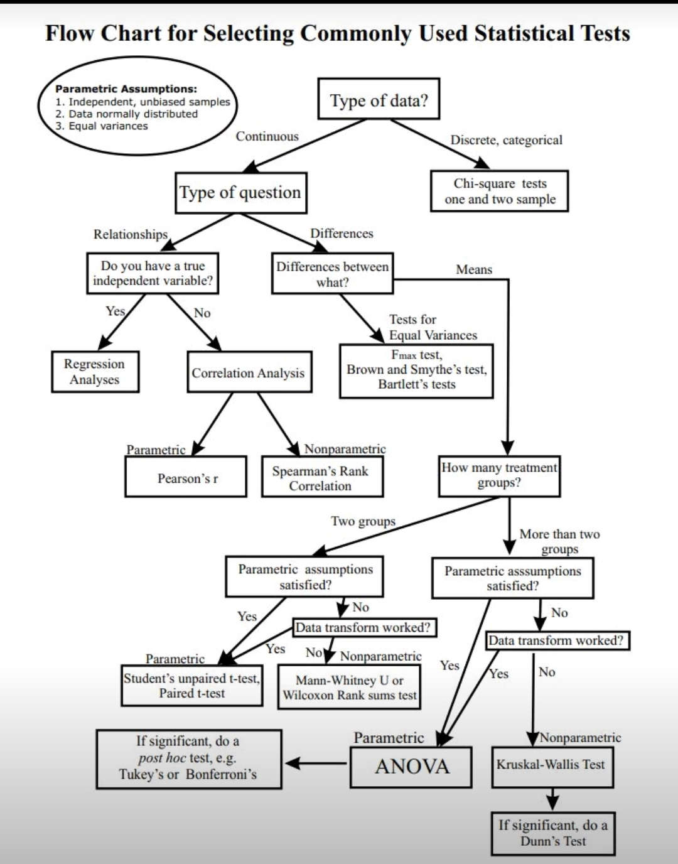
How to Select Test Type

